Slide 1
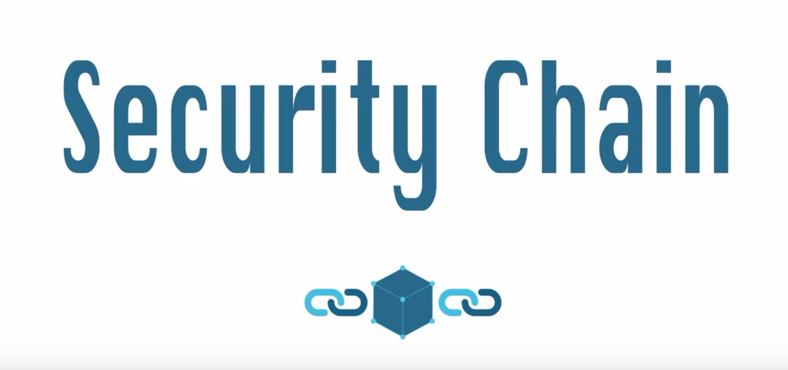
A Crime Records Blockchain DApp

Slide 2
PROBLEM STATEMENT
Traveling around the world has been made easy nowadays. But do you know, there’s on average 1,088,300 (1 million) passengers and pedestrians coming across the US border everyday? That’s a huge amount of work to perform background for everybody in real time.
Plus, since every security party has its own data center, it would be hard for a particular border in one particular country to identify a person with all their previous crime record in other countries.
So how could all the security parties safely exchange data, keep an immutable record, and preserves the ownership of the party origin?

Slide 3
SOLUTION
Meet Secure Chain, the first ever decentralized application that would help store crime records.
With blockchain technology, it has the benefit of immutable crime record shared among all police station, border customs, and securities.
It is immutable and most importantly reliable.

Slide 4




ARCHITECTURE
Database to Store criminal records
Backend Web3 API layer for transactions
And
Ethereum Node for transactions
Smart Contracts to Update Crime Records
(UUID)
React Frontend for node to update Crime Records

